Slide 1

Bus Stop Monitoring
Project by:
Pantelis glentis 1066464
Evgenia Gkagkastathi 1019191

Slide 2
Problems
Crowd congestion
Schedule delay
Bad timing of routing schedule and people movement
Unknown information about bus location and arrival time
Illegal parking on bus stations

Slide 3
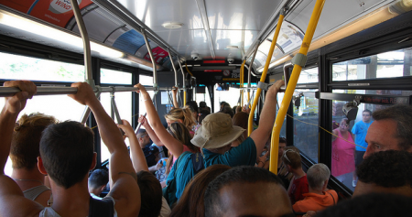
Examples of these problems expressed in press
“Εικόνες απίστευτου συνωστισμού σημειώνονται στα λεωφορεία που μεταφέρουν φοιτητές στις πανεπιστημιακές σχολές της Πάτρας. Ο συγκοινωνιακός φορέας, με την επαναλειτουργία του Πανεπιστημίου, επανέφερε το κανονικό πρόγραμμα δρομολογίων, όμως το πρόβλημα του συνωστισμού των φοιτητών σε στάσεις του κέντρου συνέχισε να υφίσταται και είναι καθημερινό φαινόμενο ιδιαίτερα στις ώρες αιχμής.” https://www.ieidiseis.gr/ellada/115392/patra-synostismos-sta-leoforeia-pros-to-panepistimio-ti-apanta-to-ktel
“Ο κ. Ρήγας έθιξε και το πρόβλημα του κυκλοφοριακού που καθιστά τις αστικές συγκοινωνίες της Πάτρας μη ελκυστικές για το επιβατικό κοινό. Οπως είπε, η κατάσταση στο κέντρο είναι πλέον δραματική και ανυπόφορη, καθώς το διπλοπαρκάρισμα έχει επιφέρει δραματική αύξηση στους χρόνους υλοποίησης τακτικών δρομολογίων. Ανέφερε για παράδειγμα ότι το δρομολόγιο για Εγλυκάδα έχει αυξηθεί σε χρόνο από 25 λεπτά σε σχεδόν μια ώρα, με αποτέλεσμα το επιβατικό κοινό να έχει μειωθεί.” https://pelop.gr/astiko-ktel-kindynevei-me-chreokopia-klataroun-oikonomika-ta-leoforeia-stin-patra/
This Photo by Unknown author is licensed under CC BY-NC.

Slide 4

Ways to overcome
AI based cameras for tracking buses, people and illegally parked vehicles
Sound sensors for detecting buses and people congestion with noise processing
Parking sensors and bluetooth tags offering real-time data about each bus and its routing schedule
Google maps roads API along with data from LoRa and Wifi/Narrowband Networks for data processing and analytics

Slide 5

How we differ
Our implementation provides a low-cost solution for:
Real time bus tracking: Bus line and station status updates
Reforming schedule based on people congestion
Contribution of data and analytics
With the unique added value provided by:
Illegal parking detection
Personalized station selection based on client location using real-time data
Flexibility in performance and complexity depending on specific station needs and budget.
Long term sustainability solution
Evolving possibilities

Slide 6


Target group
Our product’s goal is to provide data about bus traffic and offer ways to improve the quality of service. Therefore, our product is destined for:
citizens
bus companies
research groups
administration offices.

Slide 7
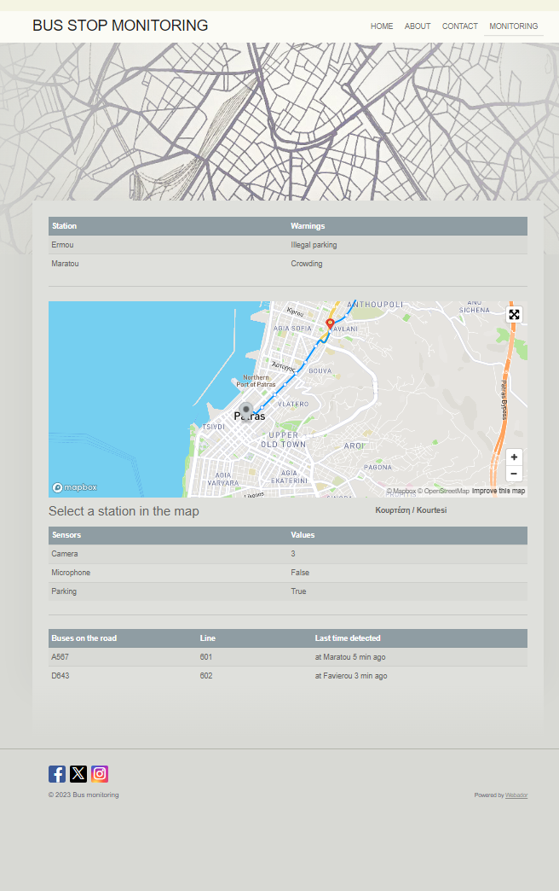
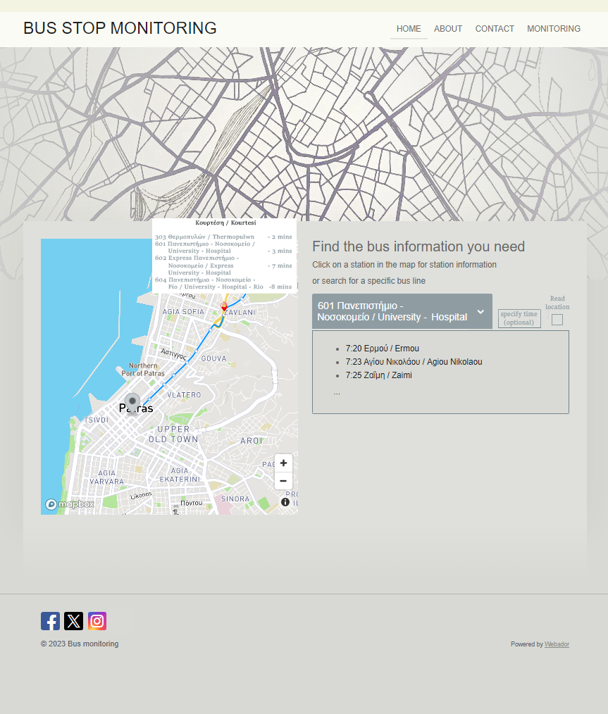
Website Draft
Features (Customer view)
Real-time bus-line information
Personalized station selection based on client location
Additional administrator features:
Monitoring:
General Warnings
Station-specific Status Report
Active Bus Tracking

Slide 8
Prices
Narrowband network - 1.24 € per month – 500 KB per month
4 types of Cameras (17.91 € – 37.81 €):
• Normal-view 1080p • Normal-view 1440p
• Wide-view 1080p • Wide-view 1440p
Raspberry pi 0 W (20.50 €)
Parking sensors (average 200 €)
LoRa gateway (50m range) (84.50 €)
Sound sensors (14.96 €)
601 bus-line subscription:
59,52 €/year
601 bus-line total cost:
1836,74 €

Slide 9
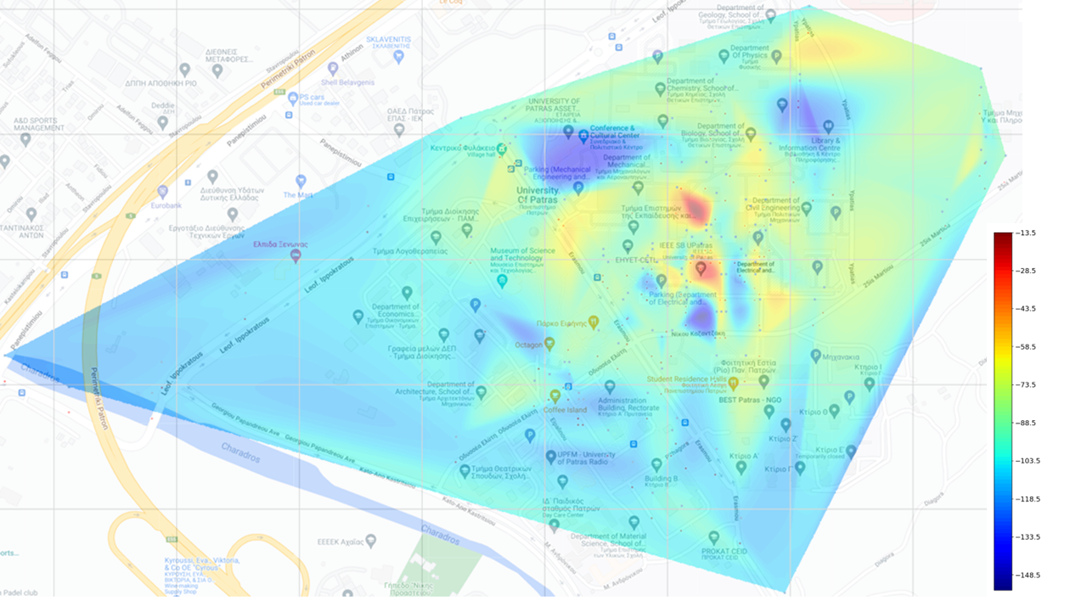
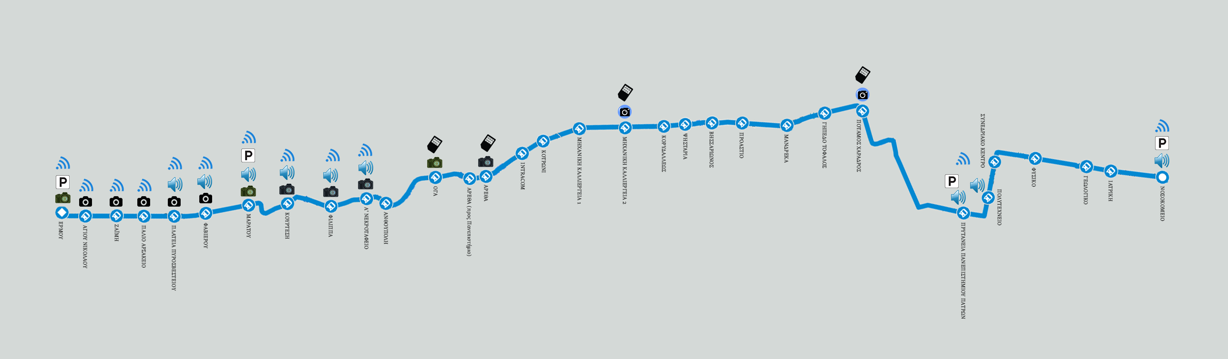
Bus-line 601
implementation

Slide 10
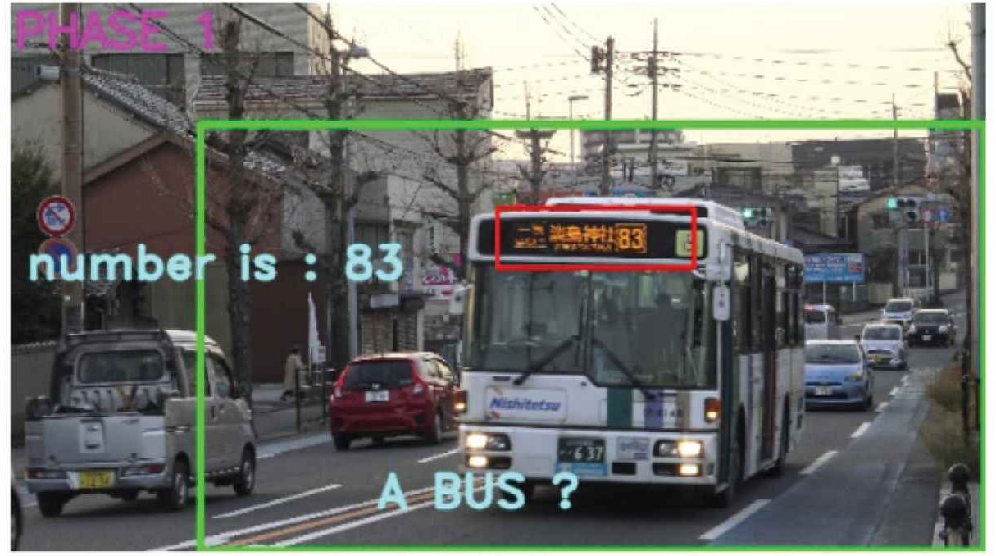
CAMERA OPERATION - AI
YOLOv.8
OCR Implementation

Slide 11
Similar applications
www.astikopatras.gr
It offers real-time schedule about bus-lines for each and every bus of Patras
Not financially-efficient implementation due to the use of GPS trackers with high-maintenance, while our implementation focuses on low-cost use of sensors.
https://jv-technoton.com/solutions/bus-monitoring-system/
Passenger load measurement (Similar to people flow sensor - counting passengers)
Maintenance optimization (maintaining vehicle or machinery fleet health, based on monitoring current operation parameters and detecting signs of forthcoming malfunctions)
Precise fuel monitoring (fuel level measurement - requirement to GPS vehicle tracking system)
Driving behavior monitoring (Notiﬁcations on dangerous driving – harsh braking, acceleration, turns, speeding)
Dispatching (Precise measurement of remaining fuel in tank and fuel consumption, sending data to dashboard. Notiﬁcations on fuel ﬁll-up and measuring from tank)
Use of:
Transmitters continuously transmit measurement results (data) to Receivers (via BLE radio)
Receivers: store the settings of all Transmitters
Mobile application for Android/iPhone OS

